Slide 1
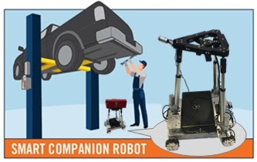
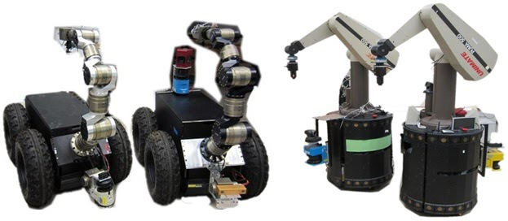

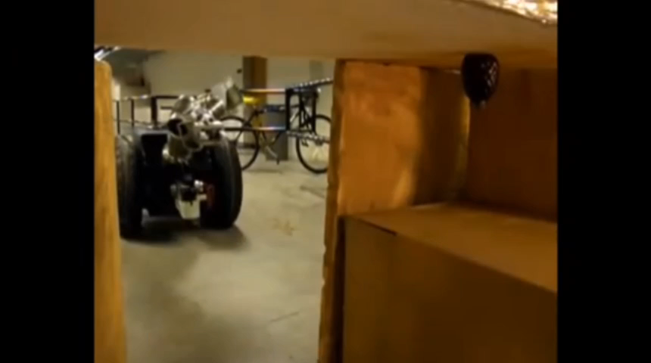


2. Intelligent Robotics 2.1 Mobile Manipulators · Mobile manipulator system development · Whole-body mobile manipulation planning and control · Holonomic vs. nonholonomic bases & Serial vs. parallel manipulators
视觉伺服
精准机械手

Slide 2
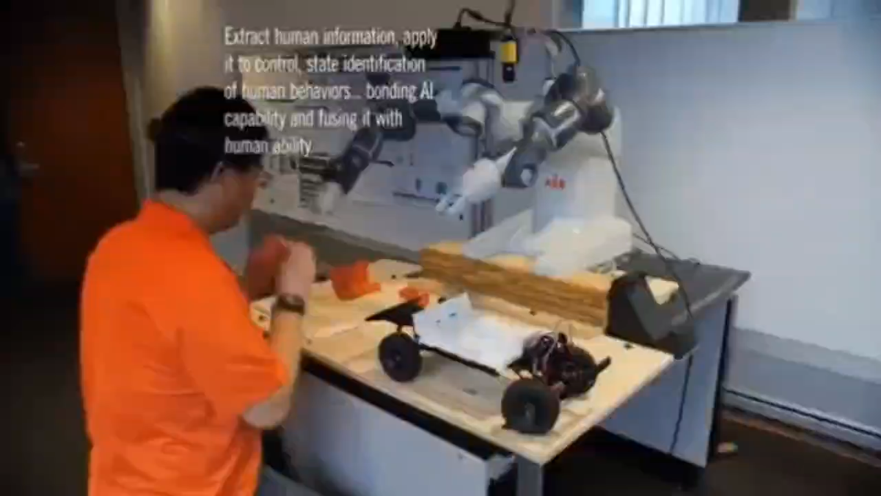
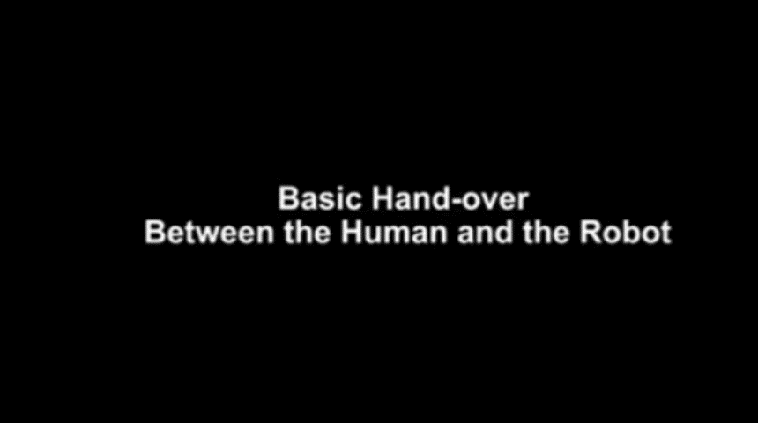
2.2 Natural Human-Robot Interaction, HRI · Modeling of human-robot collaboration tasks · Teaching and learning of tasks via natural language · Bilateral adaptation between humans and robots
人机协作
人机被动-主动交互

Slide 3
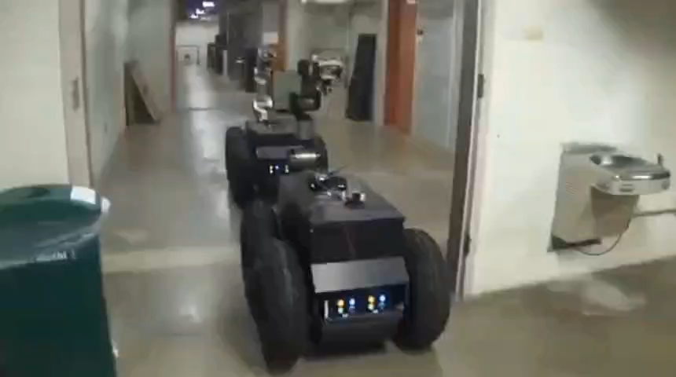
2.3 Multi-Robot Systems, MRS · Distributed multi-robot coordination · Coordination with communication constraints · Coordination with environmental uncertainties
MRS
）

Slide 4
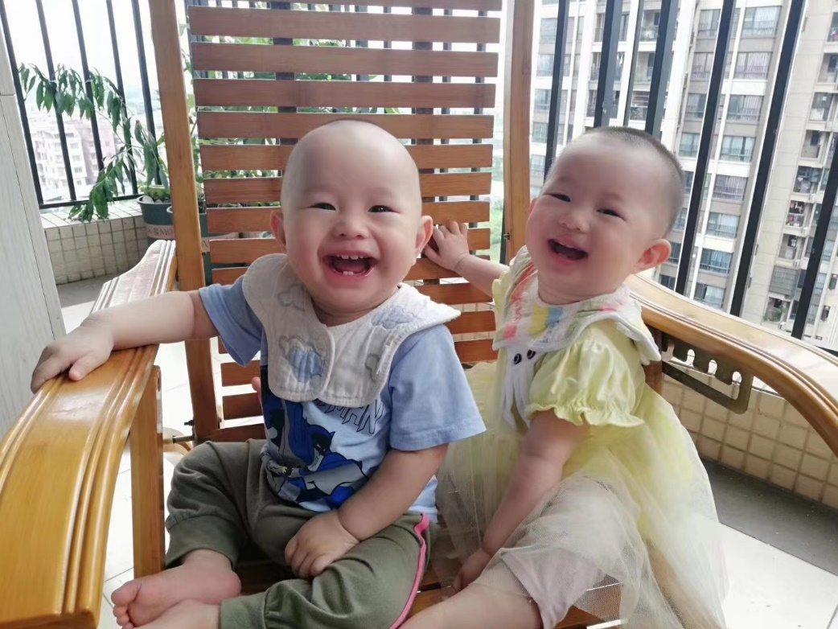
The End. Thanks

